Slide 1
GAS LP: Energía Excepcional Rol del Gas LP en el Análisis del efecto invernadero XXVI Congreso de la AIGLP
Michael Kelly
7 abril 2011
Santiago de Chile
Notes:
Good morning everyone and thank you for inviting me to speak to this esteemed group of leaders from the US propane industry.
I know that some of you know the WLPGA well while others probably less so.
The aim of my talk this morning is really to pique your interest in the WLPGA and importantly, in the world of Propane outside the USA.

Slide 2
Agenda
20 MINUT0S
Notes:
I have 20 minutes to get my message across to you
In that time I want to tell you about the WLPGA; provide some context of the global industry
I will focus on general transversal opportunities in the industry, using examples from around the world outside the US.
Finally I will look more deeply into a couple of important areas of growth – domestic use and automotive.

Slide 3
WLPGA en resumen rápido
90+ diferentes países
200
compañías socios
56% aumento en cuotas de países en vía de desarrollo desde 2005
La única Asociación global que representa a la industria de GLP
Notes:
The WLPGA is the unique body that represents the Propane industry globally.
We currently have around 200 members, representing the leading companies in the sector. In the US we have 15 members including PERC and the NPGA as well as Ferrellgas and Amerigas and some of the leading equipment manufacturers.
Our aim is to promote the use of propane and butane worldwide and we do this through our team in Paris but also in strong cooperation with our members who are operating in over 90 countries.
We are the global voice of the industry and over the last decade or so our influence with key opinion leaders and policy makers has increased enormously.

Slide 4
La industria de GLP
$300MM
240 millones de toneladas consumido p.a.
2,000,000
empleados
Notes:
Now, let me say some things about the scale of this industry we all work in.
Firstly, if you compare us to a large international company we have about the same sales as Exxon Mobil at 300bn USD
That revenue comes from the sale of 240 million tonnes or 120 billion gallons per year.
Note that a large and growing proportion of this sales is coming from Petrochemical feedstock. Much of this is price sensitive i.e. It displaces other feedstocks if the price is right which happens when production exceeds premium demand. This industry has an opportunity to grow premium demand globally
This industry also employs some 2 million people – significantly more than Exxon Mobil! Improved cooperation and collaboration between these employees working in thousands of companies is an enormous opportunity for the global LPG business.

Slide 5
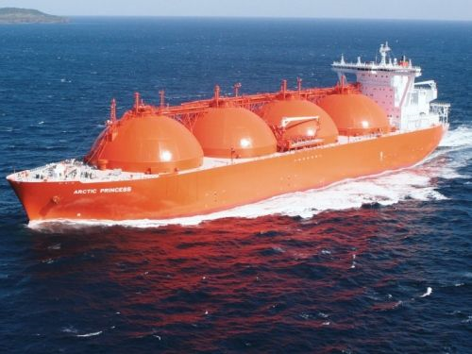
La industria de GLP
1.4x
Mas Grande que la produccion global de Gas Natural Licuado (GNL)
Notes:
We lack scale economy in many areas but one important area is in communications and positioning
As an example LP Gas is thought of variously as a niche fuel, as a fuel for recreational purposes ...Basically as a rather unimportant contributor to the global energy picture.
Ask many policy makers however about LNG. They won’t much but they will be sure that it is a major element of the energy mix.
LPG is 140% the size of LNG and we are growing. LNG companies are fewer and larger than ours and they have this “scale economy” of positioning. We need to do something about that.

Slide 6
La industria de GLP
3mil millones
de usuarios mundial
½
de la población del mundo usa GLP
Notes:
To give you more idea of scale consider that almost half the world’s population is a consumer of LPG.
Natural gas doesn’t begin to approach that figure. We are the peoples fuel because LPG is transported and retailed in small volumes through an enormous number of channels and points of sale. As an example in just one country – India 3 million hole deliveries are made every day or 35 every second.
With this scale policy makers need to have LPG near the top of their priorities.. Our job is to make them aware.

Slide 7
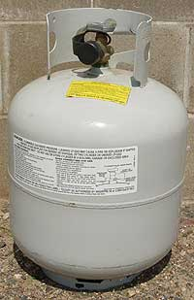
La industria de GLP
La indusria de GLP ha hecho enormes inversiones en infrastructura…
OCHO vueltas al mundo.……
Notes:
One last point on the context of industry. If we were to stand all the LPG cylinders in the world side by side, they would form an uninterrupted chain that would stretch eight times around the world. That is quite some infrastructure and doesn’t even consider the caverns, pipelines, filling plants, bobtails and trucks .

Slide 8
Asociaciones
30associaciones nacionales y regionales
Que gastan cada ano$100m
Muchos enfrenten a las mismas problemas...
Notes:
Now lets turn to us – national / regional /global associations
Within the WLPGA we have approx 30 national or regional members (although given that LPG is consumed in every country in the world that figure is also quite small)...
We estimate that these orgainsations spend about $100m each year (not including PERC and NPGA)
Yet many of these orgainsations face the same issues. We need to improve our cooperation, identify synergies and align our activities.

Slide 9
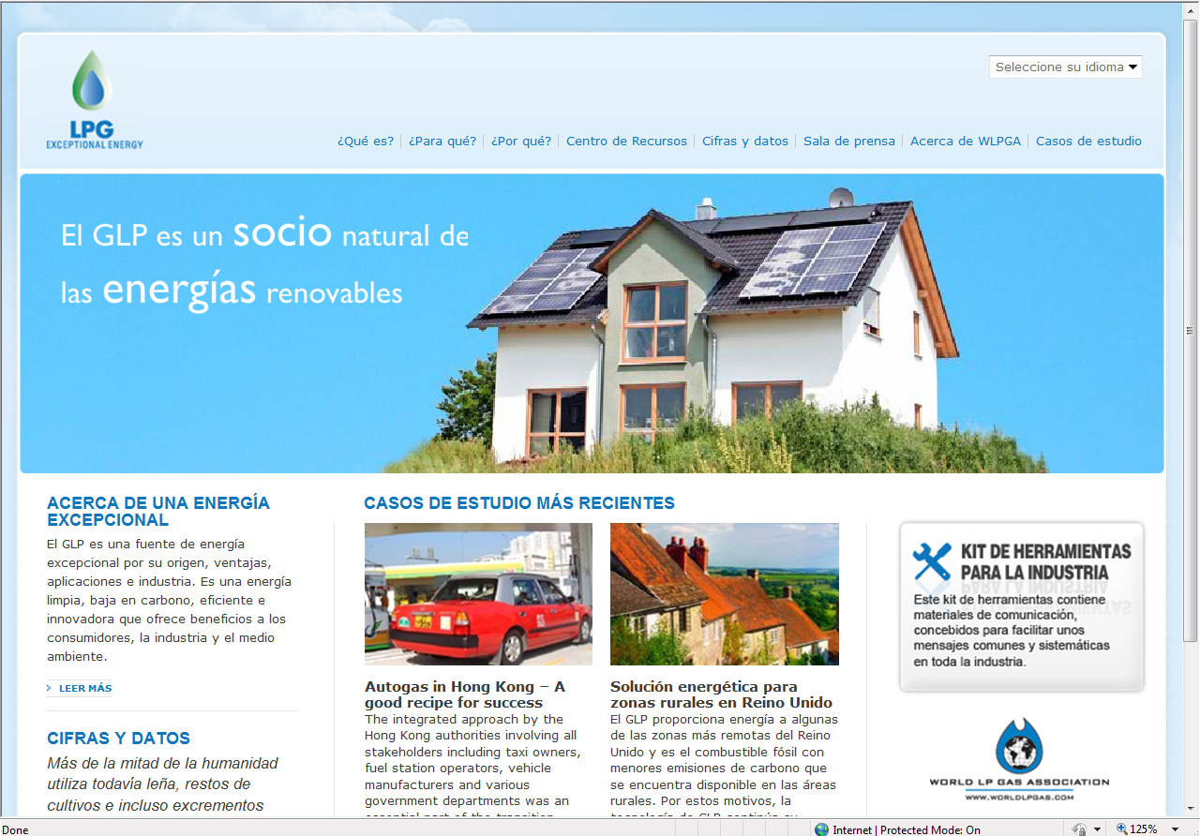
Oportunidades para al industria – mejor comunicaciones
GLP, una energía excepcional!
Sito Web Energía Excepcional
Casos de estudio de todo el mundo
Cifras y datos
Sala de prensa
Centro de recursos
‘Kit de Herramientas’ para la industria
Notes:
Coming back to the need for scale economy in communications: One of the major initiatives the WLPGA has been involved in recently is to build on Propane Exceptional Energy and develop a global branding of “LPG Exceptional Energy”.
We are now busy rolling this out outside the US, providing everyone with common data, common positioing...
This is an example of the home page of the web site Excpetional Energy.com.

Slide 10
Kit de herramientas de comunicaciones
Disponible gratis para miembros de la WLPGA
Pretende ayudar a que el conjunto de la industria se exprese con una misma voz
Contiene material de comunicación y material gráfico
Contenidos para presentaciones, materiales de comunicación y material gráfico, del tipo de carteles, publicidad, folletos, campañas en línea, plantillas de páginas web y recomendaciones sobre relaciones con los medios
Notes:
We have launched an advertising campaign using superboy – giving a feel that LPG is young , represents the future and holds enormous promise for the future.
Launched at the World Energy Congress in Montreal a couple of months ago and subsequently at our own annual forum in Madrid.

Slide 11
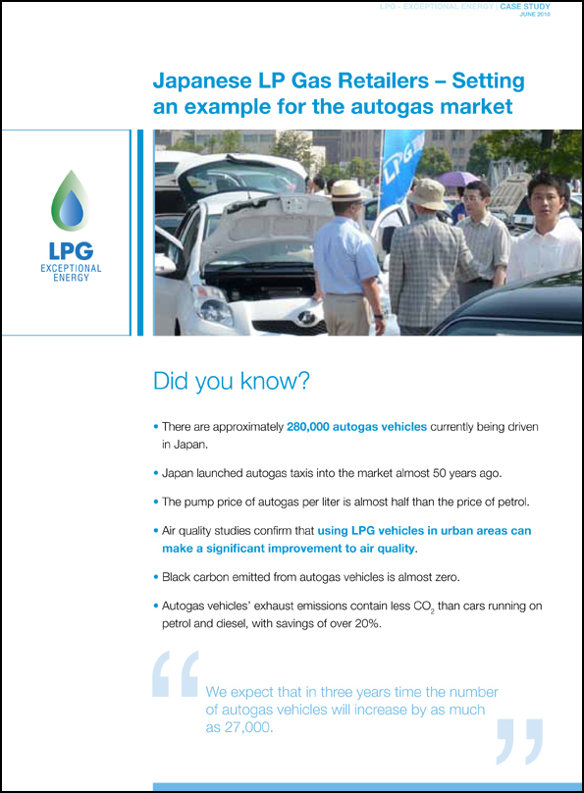
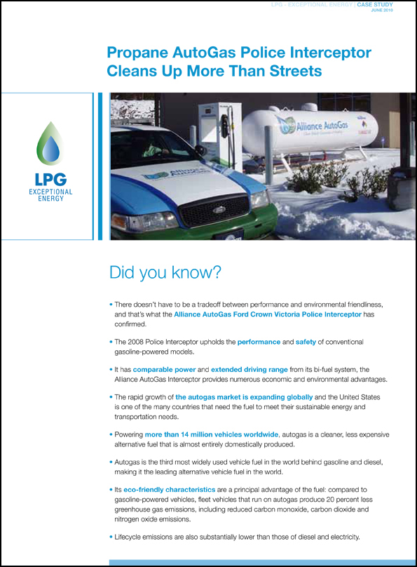
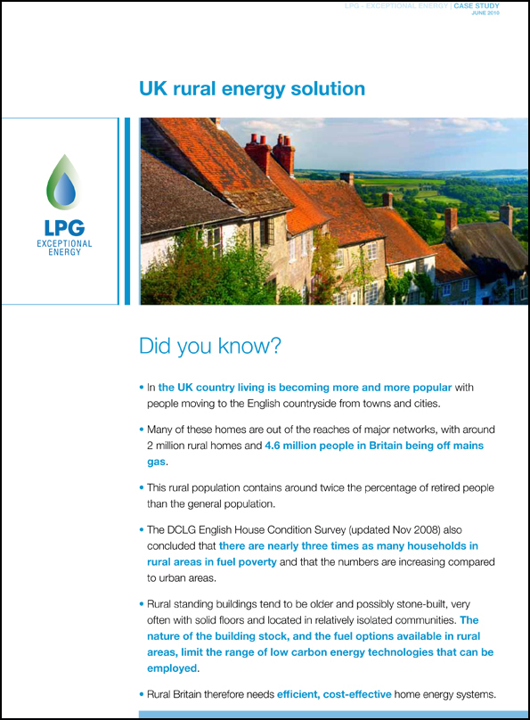
Casos de Estudio, de todo el mundo
Casos de Estudio – demostrando los éxitos del la industria
Notes:
In addition to the adverts, we have prepared many case studies from across the world from different segments – these are being used to communicate the scale and scope of our industry.

Slide 12
Oportunidades para la industria – cambio climático
El propano y el butano no están en la lista del PICC de los gases de efecto invernadero
Limpio y muy eficiente en usos térmicos
GLP tienen menos dióxido de carbono (CO2) que la gasolina, el diesel, etanol y otros tipos de energías
GLP emiten menos gas de efecto invernadero que otras opciones sin disminuir rendimiento en muchas aplicaciones
GLP son extensamente disponibles, portátiles y almacenables

Slide 13
Oportunidades para la industria – cambio climático
“El GLP emite alrededor de un 20% menos CO2 que el fueloil de calefacción y un 50% menos que el carbón
El GLP emite un 50% menos de gases de efecto invernadero que algunas cocinas de biomasa
19% menos que las cocinas de queroseno
Notes:
Another opportunity for LPG is in the climate change debate.
Thanks to some excellent work done by PERC you know that propane has a lower impact on the environment than many other fuels
But did you know that for instance in India LPG has 60% less GHG emissions than a popular cookstove – the elcetric coil?
Or that in Eastern Europe LPG has almost 60% less GHG impact than appliances using grid generated electricty?
This data is available in a WLPGA study [hold up]

Slide 14
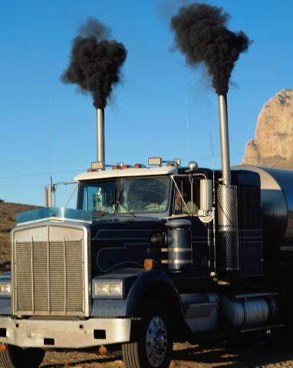
Opportunities for the industry – Climate Change
Carbono negro (hollín): 2^{O} contribución en importancia al calentamiento global y causa problemas de salud graves
0
Qantidad de Carbono negro emittdo pour GLP
Notes:
An hugely important contributor to Climate Change, but one that is only recently being recognised is black carbon, or soot. It is the second largest contributor to climate change after CO2
The good news for us is that LPG emits practically zero black carbon.
Take a look at the report that we released last month [hold up copy]

Slide 15
Oportunidades para la industria – cambio climático
COP
Diecisiete
Notes:
The efforts of the WLPGA on behalf of the world industry are focused on the annual COP meetings. You will probably have heard of the Copenhagen discussions last year... That was COP 15.
This year we will be at COP 16 in Mexico and next year at COP 17 in South Africa. Theses conferences will define the successor to Kyoto and it is essential that LPG is fully considered.

Slide 16
Usos domestico - Concinar
Más de 1.6 millones de personas mueren prematuramente por causa del uso de los combustibles tradicionales – mas que por el paludismo. Organización Mundial de Salud (OMS)
Pobulacion rural de India: 840 millones
1.2
mil millones de nuevos usuarios en 2030
Notes:
Perhaps the greatest opportunity for our industry is in the domestic sector.
1.6 million per year die prematurely from indoor pollution – essentially from cooking – equivalent 1 every 20 seconds.
LPG is a preferred fuel according to many organisations including the WHO - this gives us tremendous leverage.
Take India as an example with a rural population of 840 million which is greater than the population of the European Union, The United States and Canada combined
LPG Penetration is just 20%
The Indian government plans a 150% growth in LPG consumption in rural areas = > 50 million new connections by 2015.
Finally in a scenario prepared by the International Energy Agency, nearly 1.2 billion people will switch to LPG by 2030, each consuming 22kg/yr. - equiv. 22.9 million tonnes/yr.

Slide 17
Autogás
Autogás es el carburante alternativo más extendido en el sector de automoción, con más de 16 millones de vehículos en todo el mundo
50%
40%
menos de monóxido de carbono
35%
menos de hidrocarburos
menos de óxidos de nitrógeno que la gasolina
Notes:
The last segment that i want to present is automotive. Globally this has been fastest growing segment in the last 10 years and now represents just under 10% of all LPG consumed worldwide.
[Read slide]

Slide 18
Vehículos en le mundo 16 millones
En Australia 65% de GLP viene usado para Autogás
28%
Tasa de crecimiento anual en India
Notes:
Lets look at some data from around the world:
15 million vehicles in the world run on LPG making it the worlds most popular alternative fuel. It is clearly the world third fuel behind gasoline and diesel.
In Australia 65% of LPG consumed is used as autogas – a market with 700,000 vehicles on the road and strong government support.
Indian autogas is growing at a staggering 28% per year with 15 OEM now offering factory-fitted LPG models.

Slide 19
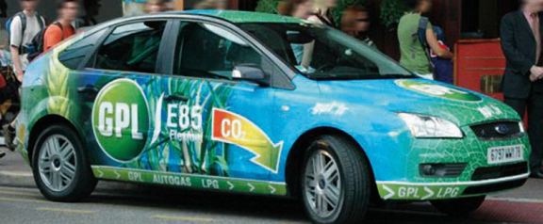
50x consumación en Corea vs. USA
2.5 Millones de vehículos en Turquía
Por la primera vez el uso de Autogas supero el consumo de gasolina en 2009
4 de cada 10 vehículos privados en Turquía
Notes:
How can it be that Korea with a GDP per capita 65% that of the United States has an autogas consumption per capita that is 50 times greater.
Note that Korea imports all its LPG.
In Turkey, 2.5 million vehicles now run on LPG – a growth from almost zero 10 years ago to the point where autogas is now the second fuel – greater the gasoline!
The simple reason in each case is enlightened governments providing suitable environment for market growth – being favourable taxation; capital grants for conversion; access to low pollution transport corridors or green procurement targets for public fleets.

Slide 20
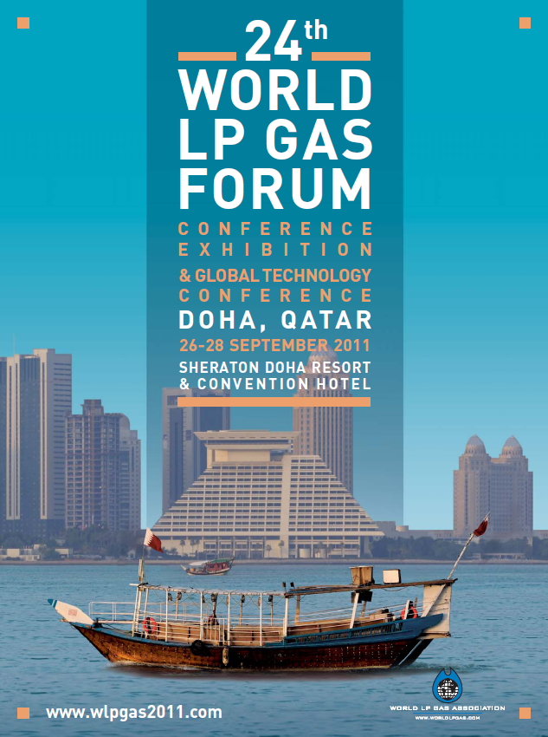
What Next??
Doha, Qatar 26 – 29 septiembre 2011
No falten!
El 24eno Foro Mundial de Gas LP
&
Conferencia de Tecnologia Global
(GTC)
Notes:
Finally, next year we will hold our annual world forum in Doha, Qatar.
To give you an indication of how successful this will be consider that the trade show sold out entirely at the launch of sales a few weeks ago at our event in Madrid.
The forum will cover high-level strategy as well as business development opportunities and a global technology conference –
Something not to miss!

Slide 21
Gracias
mkelly@worldlpgas.com
Notes:
If you want any information about the WLPGA, membership possibilities or our activities please don’t hesitate to contact me.
Thanks

