Slide 1
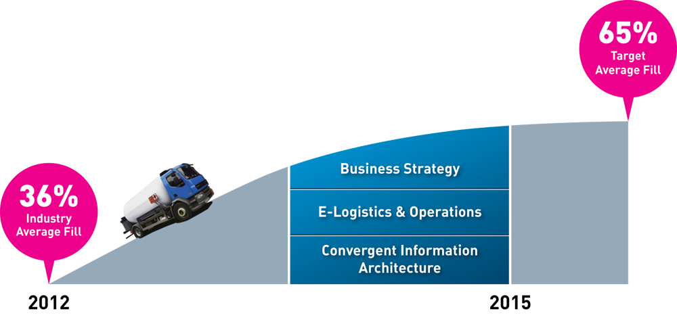
The Road to 65% Average Fill
GLOTEC, Mexico City
March 2013
Brian Kline
360.635.3496
briank@siliconcontrols.com

Slide 2
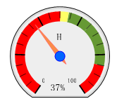
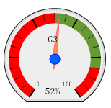
AGENDA
WHERE DOES TANK MONITORING FIT IN?
WHY DEPLOY TANK MONITORING?
HOW DO LPG PROVIDERS INCORPORATE TANK MONITORS?
WHAT TO LOOK FOR WHEN SELECTING TM TECHNOLOGY?
HOW MATURE IS THE TELEMETRY MARKET?
WHAT HAS ONE LPG COMPANY ACHIEVED?
WHAT HAVE WE LEARNED IN THE LAST 10 YEARS?
2010 37%
2012 52%

Slide 3
GASLOG Services - tank level to truck delivery
WHERE DOES TANK MONITORING FIT IN?
Truck Route
Tank Sensor (Gauge to signal)
Customer/Site: Address
Customer Tank
Bus. Apps.
ERP & Scheduling
Tank monitor (GSM unit)
Communications manager
B. Management suite
C. Report Scheduling
Operational data
Levels, Alarms, Diagnostic data
Customer, Site, Tank
updates
ERP Interface
Configuration data
Tank, Alarm, site settings
Tank Levels & Alarms
Telemetry
management
B.
Cellular/PSTN or Wireless
Networks
Secure Internet/LAN access
Central
Database
A.
C.
D.

Slide 4
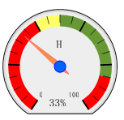
WHY DEPLOY TANK MONITORING?
2009 to 2011
236,374 sites
1,039,000 deliveries
Payback in 1 year
Payback 1-2 years
Payback 2-3 years
Industry average fill ~33% despite rapidly falling cost of technology

Slide 5
WHY DEPLOY TANK MONITORING?
Industry Average
33%
Analysis of 1,039,000 deliveries shows an average delivery size of just 33%
The majority of customers receive 5 or less drops per year, with most drops being less than 40%
Tank monitors increases avg fill by 60-80% within 3 months of deployment
Reducing drops & associated variable costs and ultimately requiring less trucks
Improves customer service in an increasingly competitive energy market

Slide 6
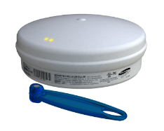

HOW DO LPG PROVIDERS INCORPORATE TM?
Assess fill efficiency and calculate ROIs
Evaluate technology, run trials (50-500 units)
Integrate TM level with ERP
Estalbish % of un-forecastable customers
Evolve operational processes
Integrate with scheduling system
Reduce variable costs and # of trucks
Rollout to 30% of tanks
Integrate with routing & on board truck computing
Unique selling point
Customer web portal
Move customers from will call to forecasted delivery based on benefits
Investigate other applications
A
B
C
D
A
B
C
D
Key to distribution efficiency &
a platform for customer service
E

Slide 7
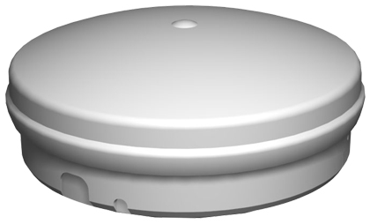
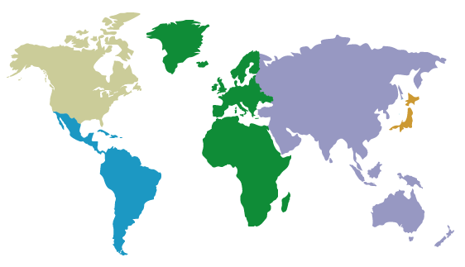
WHAT OTHER APPLICATIONS DOES TELEMETRY SUPPORT?
E
Tanks & Cylinders
Float Gauge
Magnetel
Ultrasonic
Meters
Cathodic Protection
Pressure
Temperature
Auto Changeover
Cage Door Monitor
Cathodic Protection
Metering
Reticulation
Auto Change Over
Cages
Notes:
CONCLUSION
By making telemetry information a pervasive service, new opportunities are created for gaining commercial advantage and reducing cost.
The GASLOG Solution
Supports a diverse and increasing range of applications, e.g. cylinders, bulk tanks, meters, cylinder exchange cages, mobile assets, truck computers…
CGASLOG Communications
Supports cellular (fixed/mobile), telephone (PSTN), Internet (USB), third party (serial)
GASLOG Server
Database driven solution for storage/retrieval of site data, system configuration and administration
Distributed redundant servers, multiple time zones, daylight saving, system audit trail
GASLOG Eagle
Web based system administration and reporting tool
Provides an alternative interface for sales force, consumers, field support staff, transport partners…
Sophisticated and flexible user access security
Optional services include forecasting, scheduling, routing, mapping…
GASLOG Gateway
Secure, web based delivery of data to internal business applications

Slide 8

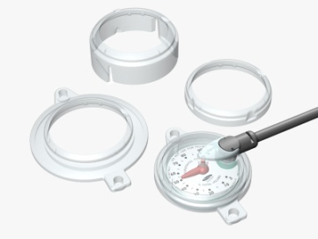
WHAT TO LOOK FOR WHEN SELECTING TM TECHNOLOGY?
Ease of Deployment
Low Cost of Ownership
Quick, simple installation <10mins
Hazardous area Zone 0 certified
Configured remotely
Battery operated (5 year life)
Driver install
Low equipment cost
Minimize comms. cost
Minimal maintenance
Robust and reliable
Modular, Adaptable Components
Ease of integration with back office
Range of networks (GSM, RF, PSTN)
Multi & single tank solutions (Virtual)
Digital & Analog inputs (e.g. meter & level)
Range of unique sensor solutions
Common plug & play architecture
Notes:
Show the SC414 and explain this slide by showing off the product
show ”the only tools you need” i.e. magnet and key to open the lid
removing base plate, explain that the sim card is certified as part of the product, show that the battery is an integral part of the product, highlight the detail in engineering – a “post” to store battery nuts etc.
Ease of Deployment
Quick, simple site installation – as little as 5 minutes by a delivery driver
No special tools or skills – just a tube of adhesive or a screwdriver
Factory fitted SIM – nothing to do, just turn it on and use it
Once installed, the settings and changes to settings, such as alarm levels, frequency of sampling, tank template are downloaded from the server.
The installers job is to attach it to the tank, connect the sensor and wake up the device, the system manager takes over from there.
Because GASLOG is zone 0 intrinsically safe, there is no need to work out where the RTU can be placed relative to hazardous zones. This reduces the need for specialised training of installation staff and detailed planning of where to place the device.
Calor Gas uses its delivery drivers to install GASLOG on tanks and pays them an additional 10 minutes of labour per install.
A battery life of 3-5 years and the ability to roam across cellular networks, combined with self diagnostic reporting minimises maintenance requirements to either changing the battery or replacing the device.

Slide 9
HOW MATURE IS THE TELEMETRY MARKET?
Calor Gas
BOC
Ipragaz (Turkey), Liquigas (Italy)
Primagas (Benelux, Spain, Denmark, Norway, Czech R, Slovakia)
Philippines, India, Pakistan, China
Amerigas, Inergy, Suburban, Blossman Gas, Thompson Gas, Growmark, Revere Gas, TruPointe, SOS Fuels, Delta Liquid Energy, United Landmark, Air Liquide…
BOC
Contact Energy
BOC, Elgas, Kleenheat
Origin Energy, Vital Gas
  Telemetry is not new, these companies have deployed 90,000+ units
Notes:
CONCLUSION
By making telemetry information a pervasive service, new opportunities are created for gaining commercial advantage and reducing cost.
The GASLOG Solution
Supports a diverse and increasing range of applications, e.g. cylinders, bulk tanks, meters, cylinder exchange cages, mobile assets, truck computers…
CGASLOG Communications
Supports cellular (fixed/mobile), telephone (PSTN), Internet (USB), third party (serial)
GASLOG Server
Database driven solution for storage/retrieval of site data, system configuration and administration
Distributed redundant servers, multiple time zones, daylight saving, system audit trail
GASLOG Eagle
Web based system administration and reporting tool
Provides an alternative interface for sales force, consumers, field support staff, transport partners…
Sophisticated and flexible user access security
Optional services include forecasting, scheduling, routing, mapping…
GASLOG Gateway
Secure, web based delivery of data to internal business applications

Slide 10
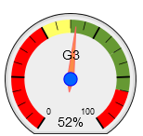
WHAT HAS ONE PROPANE DISTRIBUTOR ACHIEVED?
Case study 2003-2009
Program
Deployed 50,000+ tank monitors over 5 years
Improved integration with ERP, Scheduling
Deployed routing & truck computing
Drove operational change management program
Results
Reduced delivery trucks by 27% in same period
10% (42,000) fewer deliveries per year
Yearly reduction of 1,000,000 miles
Run outs down from 4,500/year to < 1,000/year
From 14,000 fixed day delivery to 3000
Average fill 52%
Routing &
scheduling
ERP &
forecasting
Telemetry
Tank Level

Slide 11

One approach (next steps)
WHAT HAVE WE LEARNED IN THE LAST 10 YEARS?
Assess actual payback and savings potential using historical data
Engage drivers & operational staff in deployment
Integrate tank monitoring with back office applications early
Assess performance and monitor improvements
Drive districts, targeting aggressive goals (65% average fill)
Develop a robust model to assess subsequent deployment phases
Review working practices, be prepared to modify culture
Focus on cost reduction, realize customer service improvements
Successful programs require collaboration and strong leadership
IT
Operations & Logistics
Depot Teams & Drivers
Strong Leadership

Slide 12
Thank you
“To measure is to know, if you can not measure it, you can not improve it”
Lord Kelvin (William Thomson 1824-1907)

