Slide 1

AIGLP XXVIII Congress 2013
7th March 2013
Mexico
Exceptional Energy in Action
Nikos Xydas
WLPGA Technical Director
nxydas@worldlpgas.com

Slide 2


The World LP Gas Association
The Unique Global Association representing the LP Gas Industry for 25 years
Over 200 members operating in more than 125 countries in the world
Representing the interests of the full LPG value chain from producer to distributor
Partnering with key global organisations such as the World Bank and the UNDP
As the authoritative, Global Voice for LP Gas,
the WLPGA
promotes the use of LP Gas Worldwide to foster a
Cleaner, Healthier and more Prosperous World.

Slide 3




















A Powerful Industry Association

Slide 4










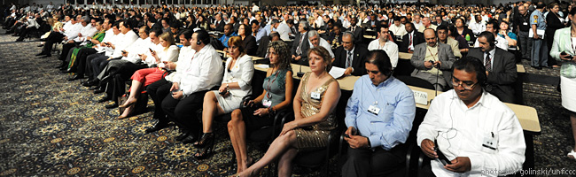
Strong links with intergovernmental organisations

Slide 5

Exceptional Energy in Action
  Imagine…. The Largest and Most Complete
  LPG Applications Database in the Industry
Welcome to:
“Exceptional Energy
in Action”

Slide 6

Exceptional Energy in Action
THE LP Gas Applications Database
  Our Vision: - Be THE reference for LP Gas Applications
  - Be top of internet searches
  - Promote the industry and our WLPGA members
  Why? - To support the positioning of LP Gas as
  Exceptional Energy
  - To stimulate the dissemination of new technology
  - To provide a complete global source – only
  national sources exist currently, no complete
  and coherent global picture
  Target: - Everyone
  We are the reference for information on LP Gas
  We have to be able to demonstrate how it can be
  used

Slide 7
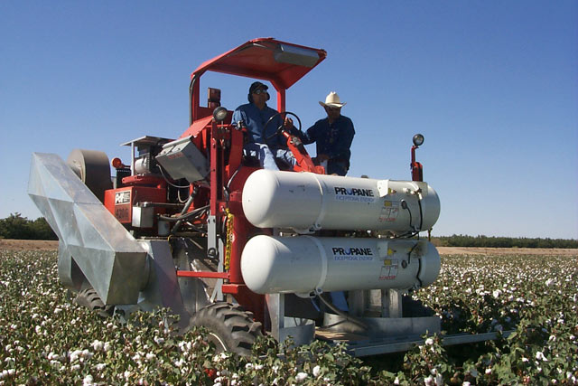

Exceptional Energy in Action
THE LP Gas Applications Database
  How: - We are already building on more than 500 applications that we have in our database
  - We have created and are further developing the WLPGA website to host them
  - We will engage with appliance manufacturers to collect more applications and data
  - We will build on and link to existing, national and other databases
  Support: - YOU! Everyone! Applications manufacturers, LPG distributors, Associations
  participation of our members and the industry is critical for our success
  Goal: - Have the database complete, launch and go-live in the
  26th World LP Gas Forum & AEGPL Annual Congress in London, October 2013

Slide 8

Exceptional Energy in Action
THE LP Gas Applications Database
The Home Page
http://lpg-apps.org/index.php?page=home

Slide 9
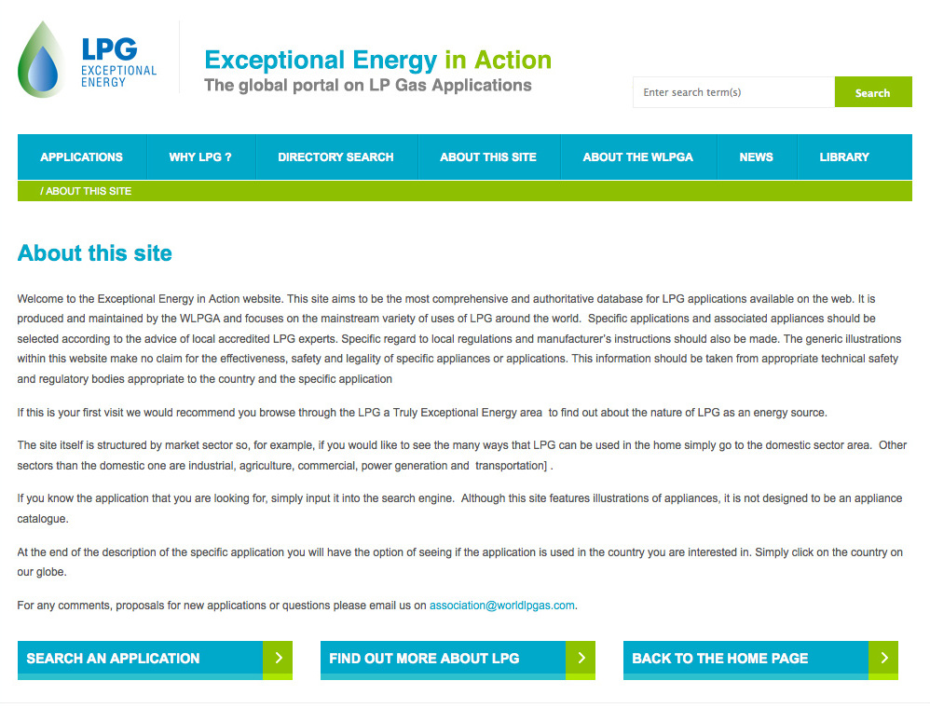
Exceptional Energy in Action
THE LP Gas Applications Database

Slide 10
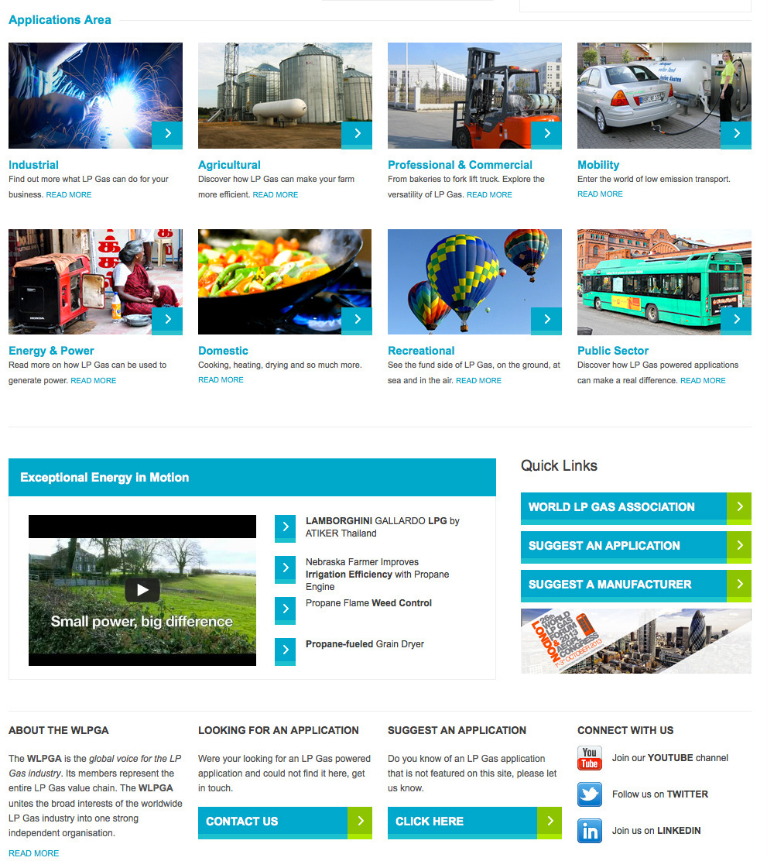
Exceptional Energy in Action
THE LP Gas Applications Database
The Home Page

Slide 11
Exceptional Energy in Action
THE LP Gas Applications Database
The Home Page
Searchable with keywords
Searchable by sector and sub-sector
Searchable by function
Searchable by geography
Main sectors

Slide 12
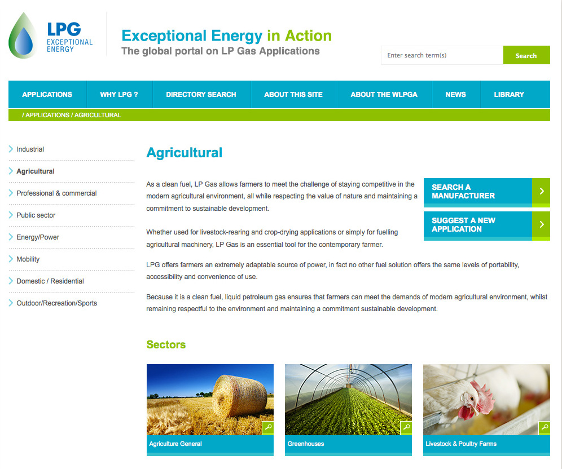
Exceptional Energy in Action
THE LP Gas Applications Database

Slide 13
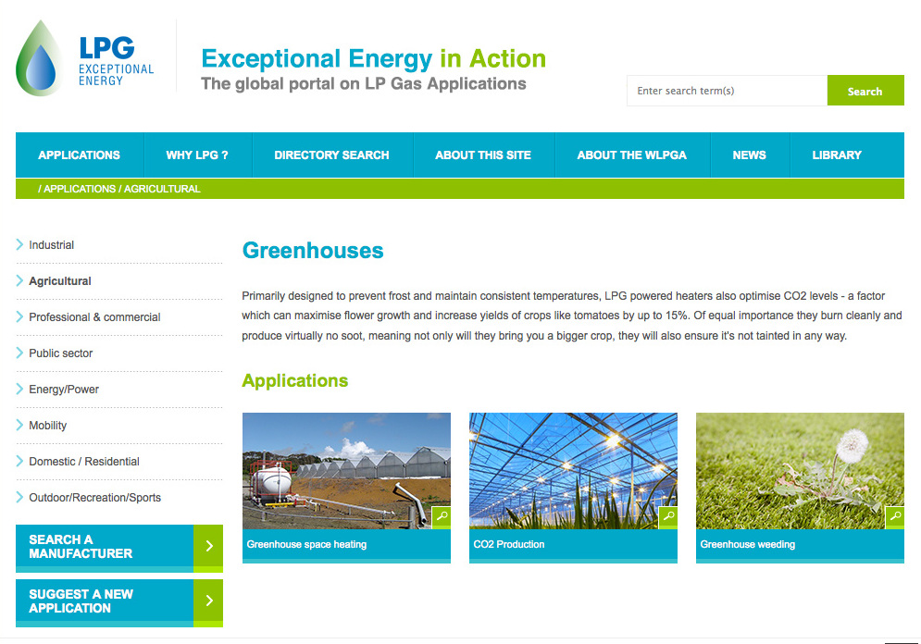
Exceptional Energy in Action
THE LP Gas Applications Database

Slide 14
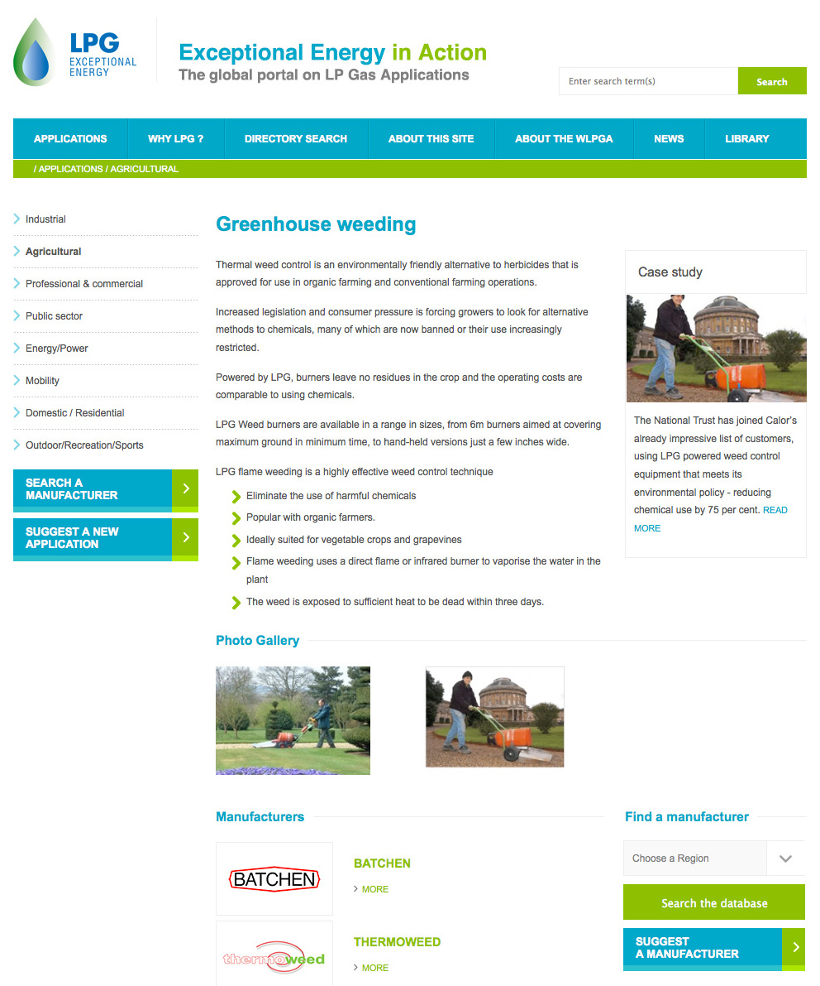
Exceptional Energy in Action
THE LP Gas Applications Database

Slide 15





Exceptional Energy in Action
The launch in London
For the launch of this very promising project, the World LP Gas Forum and 2013 AEGPL Congress in October will include a unique showcase, demonstrating many of the most innovative, interesting and important LPG applications.
Using one whole floor of the 2013 Forum, the WLPGA, AEGPL, UKLPG and our members, together with selected partners, are creating an interactive educational applications experience that will raise awareness of LP Gas.
Launched by a celebrity! High media awareness! This is the
Exceptional Energy in Action Experience

Slide 16
Exceptional Energy in in Action
Experience

Slide 17

Exceptional Energy in Action Experience
For the first time ever in our industry we are creating the
Exceptional Energy in Action Experience The LPG Applications Exhibition
This will be an interactive educational applications experience, developed together with selected partners renowned for their exceptional applications.
The aim is to raise the awareness of LP Gas as a modern energy solution in all aspects of life.
It will help position LP Gas as an Exceptional Energy, stimulate the spread of new LP Gas technologies, applications and appliances, and promote the use and knowledge of LP Gas to a broader audience.

Slide 18
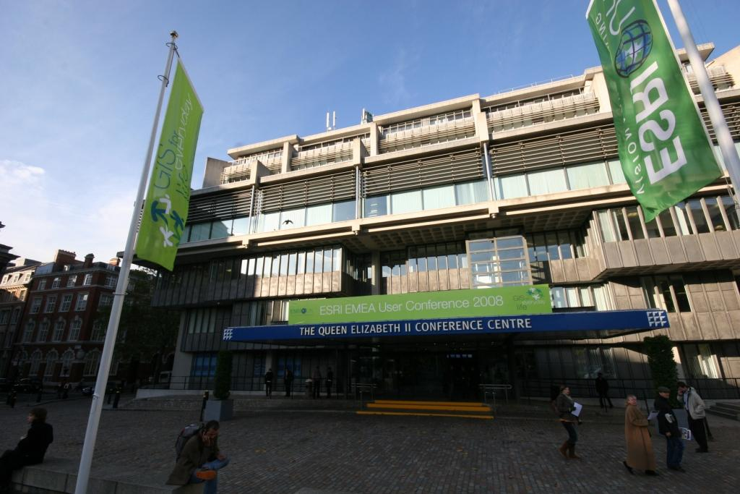
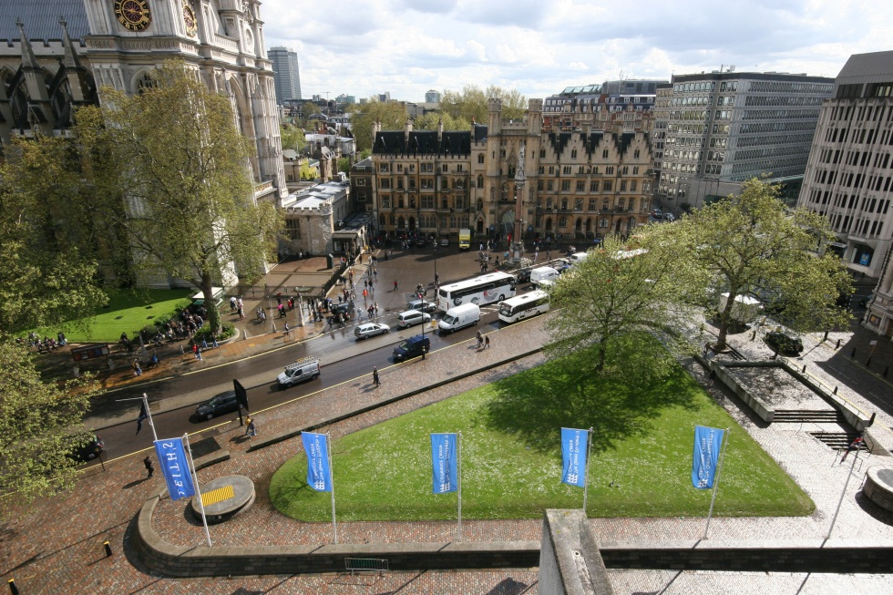
Exceptional Energy in Action Experience
The Exceptional Energy in Action Experience will cover a dedicated floor as well as an outside area at the Queen Elizabeth II Centre during the 2013 World LP Gas Forum and 2013 AEGPL Congress from 1st to 3rd October 2013.

Slide 19
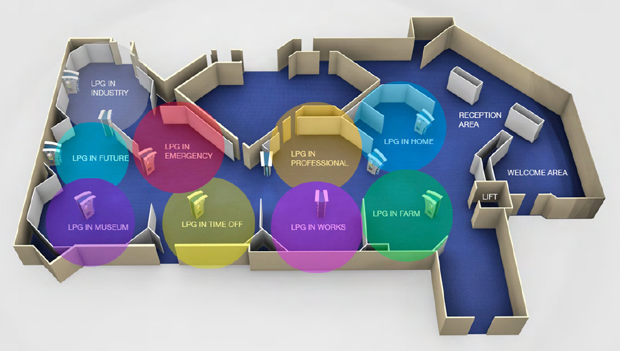
Exceptional Energy in Action Experience
Will be theme based, to demonstrate the immense variety of uses of LPG in all aspects of personal and professional life

Slide 20
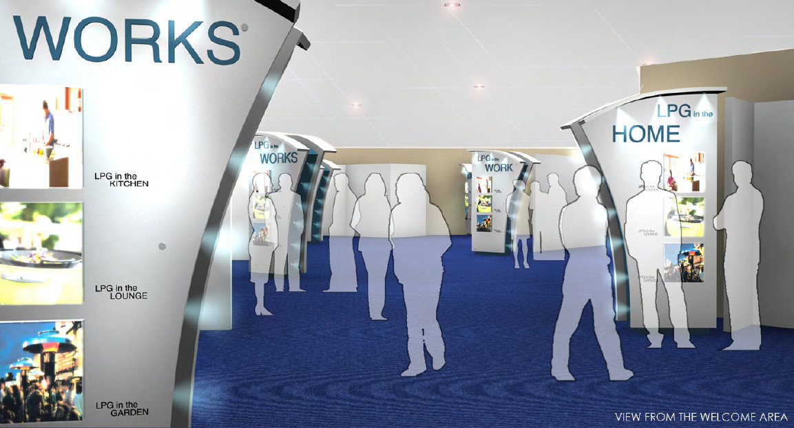
Exceptional Energy in Action Experience
The educational experience will be based on information available on printed materials, display boards, LCD screens and iPads, as well as communication sessions, demonstrating and explaining the features and benefits of hundreds of applications.

Slide 21

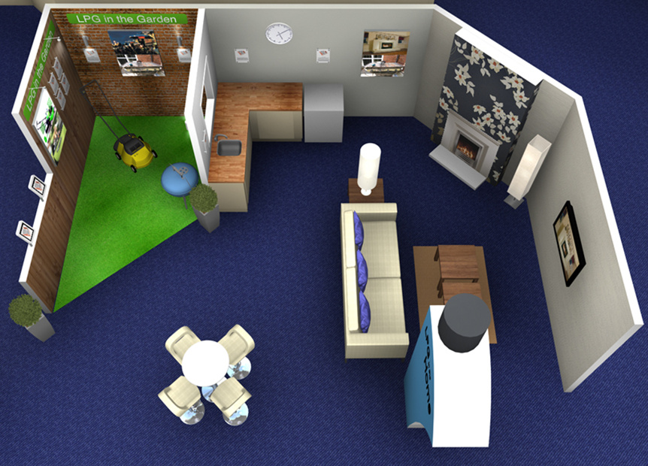
Exceptional Energy in Action Experience
The theme areas will look and feel as in their own environment filled with the best and most exciting applications available today worldwide

Slide 22
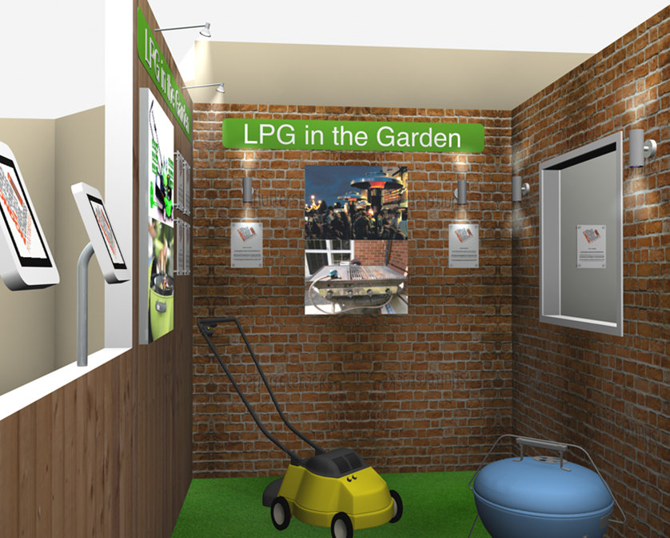
Exceptional Energy in Action Experience
The “LPG in the Garden” example. Besides the applications displayed indoors, a large variety will be displayed also outdoors and “in action”.

Slide 23

Exceptional Energy in Action Experience
The outdoor space will also be used to exhibit and also demonstrate “in action”, outdoor LPG applications

Slide 24
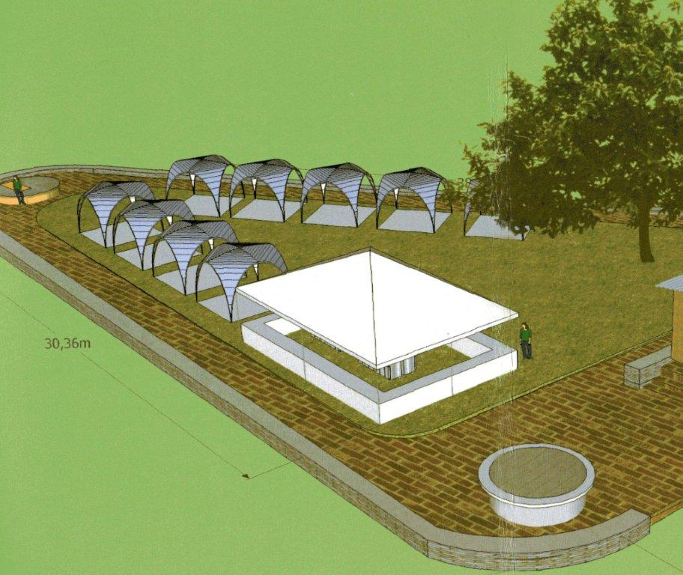
Exceptional Energy in Action Experience
It will host dedicated areas to specific manufacturers, open space for demonstrations, as well as road space for LPG fuelled mobility applications (autogas vehicles, LPG bus, Fork Lift Trucks etc.)

Slide 25
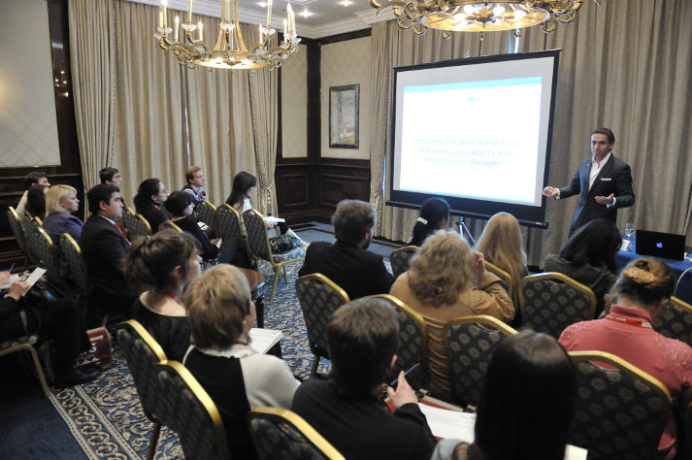
Exceptional Energy in Action Experience
Themed presentations and focus events are also planned to address specific needs of selected groups like architects, builders, installers, farmers, energy specialists, NGOs etc.

Slide 26

Exceptional Energy in Action Experience
The
Exceptional Energy in Action
(the LPG Applications Directory) and the
Exceptional Energy in Action Experience (the LPG Applications showcase)
are unique projects and events in our industry. Experience their benefits by giving them your full support.
For more information: nxydas@worldlpgas.com
See you in our 2013 World LP Gas Forum and 2013 AEGPL Congress in London.

Slide 27

Thank You www.worldlpgas.com www.exceptionalenergy.com
Exceptional Energy in Action
Exceptional Energy in Action Experience
Notes:
All that is left for me now is to thank you very much for your time and if anyone has any questions I will do my best to answer them.

